Slide 1
Data Science Practicum for Business with Python
Wayne state university
Winter/Spring 2020
Instructor: casey whorton

Slide 2
Week 1
Date: February 12, 2020

Slide 3
Overview
Intro to class topics, expectations, and schedule
Personal Introductions
Create a Github account
Create a private repo and add the instructor
Intro to Python coding language
Pandas Dataframes Introduction

Slide 4
Class Introduction & Expectations
Introduction
Each lecture will have the same format:
A quick recap of the homework due/last week’s topics, question & answer session
Presentation slides from this deck
Switch to notebooks
Expectations
Students will attend class regularly (At least 5 lectures) and be respectful of other students and instructor
Students will submit all assigned notebooks and code snippets either on a private Github repo or via email
Students will complete a final exam covering the course’s topics and score a passing grade (C letter grade)
Course is pass/fail and worth 1 credit

Slide 5
Personal Introductions
Name
Major or What you are studying
Undergraduate/graduate
What do you want to get out of this class?

Slide 6
Class Schedule (Tentative)
Schedule
Week 1 (This week): Get you started with Github, Python, and Jupyter Notebooks
Week 2: Visualize data with python, interpret graphs, distributions
Week 3: Transforming and cleaning data, make a pipeline, talk about machine learning
Week 4: Unsupervised & supervised learning, regression, log transformation
Week 5: Elasticity models & decision tree models
Week 6: Elasticity models & decision tree models, continued (hyperparameters/grid search)
Week 7: Exam & submit final notebook

Slide 7
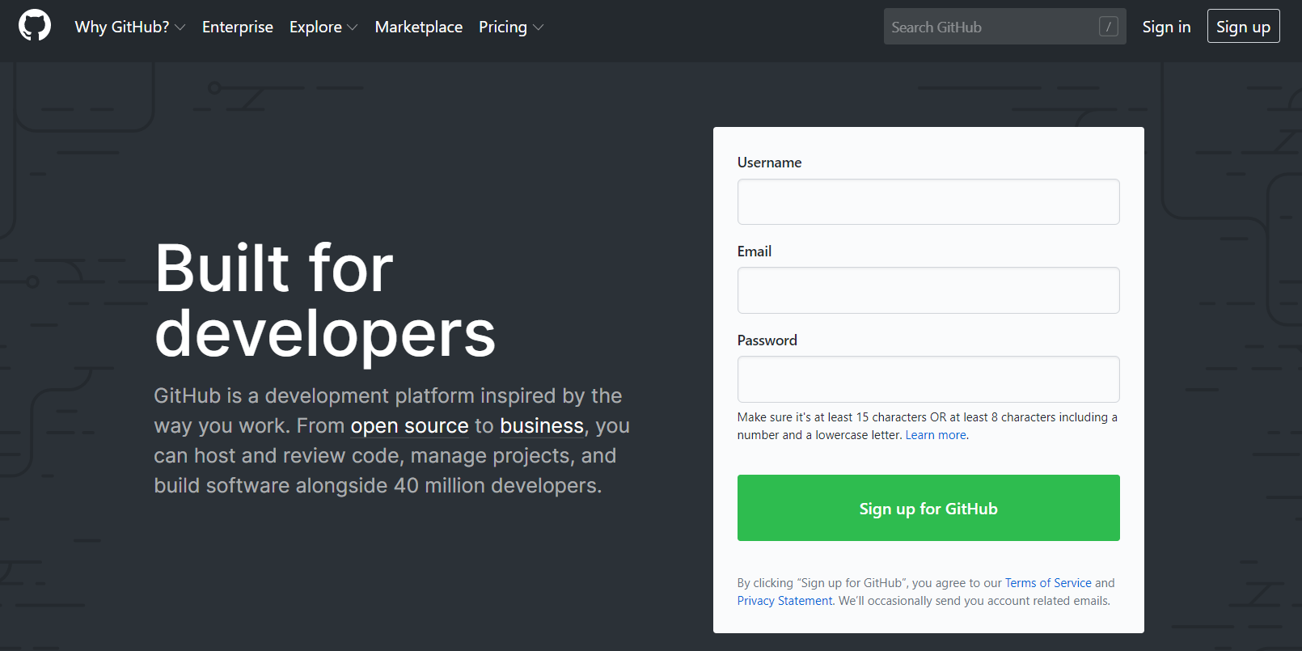
Github
GitHub is a global company that provides hosting for software development version control using Git. It is a subsidiary of Microsoft, which acquired the company in 2018 for $7.5 billion. It offers all of the distributed version control and source code management functionality of Git as well as adding its own features. (https://en.wikipedia.org/wiki/GitHub)

Slide 8
Github Account Creation
Go to github.com
If you don’t already have a GitHub account, create one with your school or personal email address
All your work for the course will be private and shared with the instructor using private repositories
Make a private repository with this name template wsu-dsp2020-<last name><first initial>
Example: wsu-dsp2020_whortonc
Under settings => manage access => add collaborators => search for “casey-whorton-waynestate” => add that person
Reference on pull requests: https://help.github.com/en/github/collaborating-with-issues-and-pull-requests/about-pull-requests

Slide 9
Intro to Python (and Anaconda)
Python is an open-source programming language
High level, object oriented, easy-to-use
Currently on version 3.8.1 (anything above version 3 is good for us)
Anaconda is a free and open-source distribution of the Python and R programming languages for scientific computing, that aims to simplify package management and deployment. Package versions are managed by the package management system conda. (https://en.wikipedia.org/wiki/Anaconda_(Python_distribution))

Slide 10
Pandas DataFrames
A dataframe is a 2d framework to present labeled rows and columns of data
Pandas is the Python package we, and most people, will use for data cleaning and data science
Link to 10 minutes to pandas dataframes: https://pandas.pydata.org/pandas-docs/stable/getting_started/10min.html

Slide 11
Homework (Due February 19, 2020)
Introduction.py
Complete and create a branch and pull request, list the instructor as a person to review
Jupyter Notebook Markdown.ipynb
Complete and upload to github
Add your name to submitted document
Numpy, math, and built-in functions.ipynb
Complete and upload to github
Add your name to submitted document
Pandas Introduction.ipynb
Complete and upload to github
Add your name to submitted document

Slide 12
Week 2
Date: February 19, 2020

Slide 13
Overview
Data Types (integers, strings, float, etc.)
Exploratory data analysis
Data distributions – Normal distribution shape and types of skew
matplotlib and seaborn – Data Visualization packages in Python
Best practices for visualizing data
Problem Description
Introduction to dataset using in course (we’ll have plenty of opportunities to learn more as time goes)
Importing data into a notebook from a flat file
Team assignments

Slide 14
Data types
Integers
Floating-Point Numbers
Complex Numbers
Strings
Boolean Type
We convert to and from data types if we need to
Use the function ‘type()’ to display the data type of an element in python, Example:
a = 123
b = str(a)
print(type(a))
print(type(b))
print(type(13/2))
Reference: https://realpython.com/python-data-types/#type-conversion

Slide 15
Automotive Terminology (FCA)
Business Center : A geographic area of the country. In North America, this is a grouping of US states.
DMA : Direct marketing area. A smaller geographic area of the country. Many to one relationship with Business Centers in the United States. Usually contains several zip codes.
Segment: Subsets of all vehicles that describe the type of vehicle. For example, the full-size truck segment contains all vehicles that are larger trucks.
Brand : A brand name for vehicles. The largest grouping of vehicles outside of segment. For example, Ram is a brand name of trucks and Jeep is a brand name of compact and mid-size SUVs.
SUV : Sport Utility Vehicle.
Nameplate : A specific vehicle that tells us and the consumer exactly what type of vehicle this is (minus trim and option distinctions). For example, “Check out my Jeep Wrangler”.
Trim (Model) : Within a nameplate, a name for the vehicle that distinguishes it from others with the same nameplate. Usually, trims are differentiated by drive-train, size, and some options.
4WD/2WD : 4 Wheel drive and 2 Wheel Drive
Options / Features : Additions or alterations to a vehicle that set it apart from others in the same nameplate or sometimes the same trim. For example, my Cherokee Laredo does not have weather-proof mud-flaps, but yours does.

Slide 16
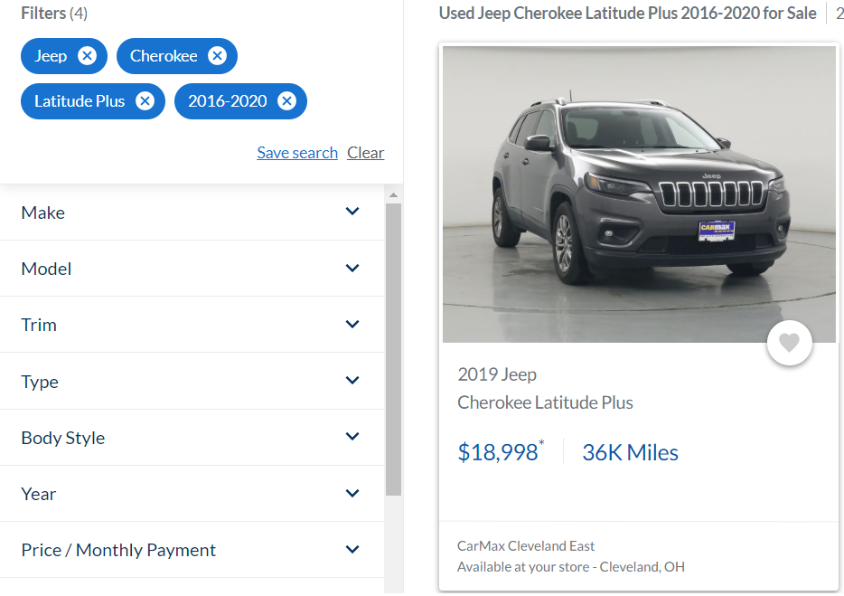
Automotive Terminology (FCA)
Note: The word ‘Model’ appears more frequently than ‘Nameplate’. This is probably the terminology used at other automotive companies.

Slide 17
More Terminology
MSRP := Manufacturers Suggested Retail Price (price before any discounts/incentives)
Margin := the profit on a product after costs have been deducted
COGS := Cost of Goods Sold (tangible costs, such as parts, material and labor)
Gross Margin := MSRP – COGS

Slide 18
Problem Description
Name Trim Model packaging
Use Case: Maximize margin through steps between trim levels, packaging, options, etc.
Final Deliverable: An elasticity model that suggests pricing gaps between trim levels, packaging, options, etc. that will generate the best volume and margin results.

Slide 19
Exploratory Data Analysis (EDA)
Exploratory Data Analysis (EDA) is a common first step in any analytics project
Consists of
Looking for missing data (null and ‘NaN’ or ‘nan’)
Looking for numerical errors and other “artifacts” (extremely high or low values that aren’t outliers)
Looking for spelling errors or differences (“Jeep Renegade” versus “Jeep Renagade” versus “jeep renegade”)
Revealing the distribution of numerical features (next slide)
Describing counts of categorical data
Displaying relationships between features (correlation, bubble charts)
Why?
Without it, analysts can report on metrics such as averages/means incorrectly
Without it, data scientists can fit models that don’t generalize well to new data
With EDA, businesses can make qualified decisions using data

Slide 20
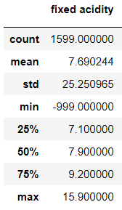
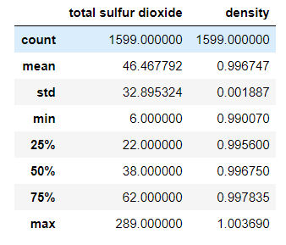
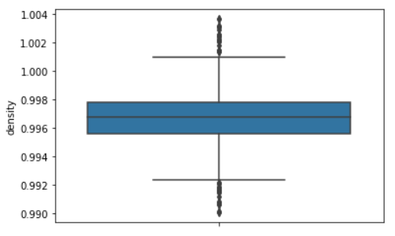
Exploratory Data Analysis - Describe
Other descriptive methods can include viewing bar charts for categorical data

Slide 21
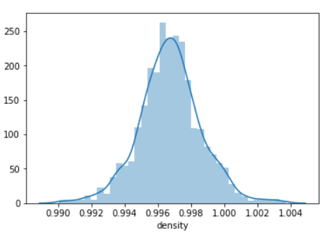
Data distributions – Normal Curve

Slide 22
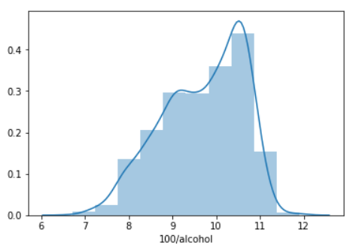
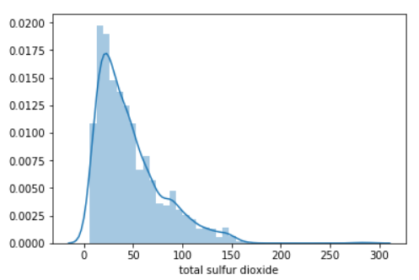
Data distributions – Types of Skew

Slide 23
matplotlib
Common package for visualizing data using the Python coding language
Very manual to create visualization, but the user has full control
Good for quick plots, but not good for something like a dashboard
We’ll use this statement to import the package: “import matplotlib.pyplot as plt”
Reference: https://matplotlib.org/
Check out the ‘tutorials’ section

Slide 24
seaborn
Another Python visualization package
Built upon the matplotlib library
Looks nicer (in my opinion)
We’ll use this statement to import seaborn: “import seaborn as sns”
Reference: https://seaborn.pydata.org/

Slide 25
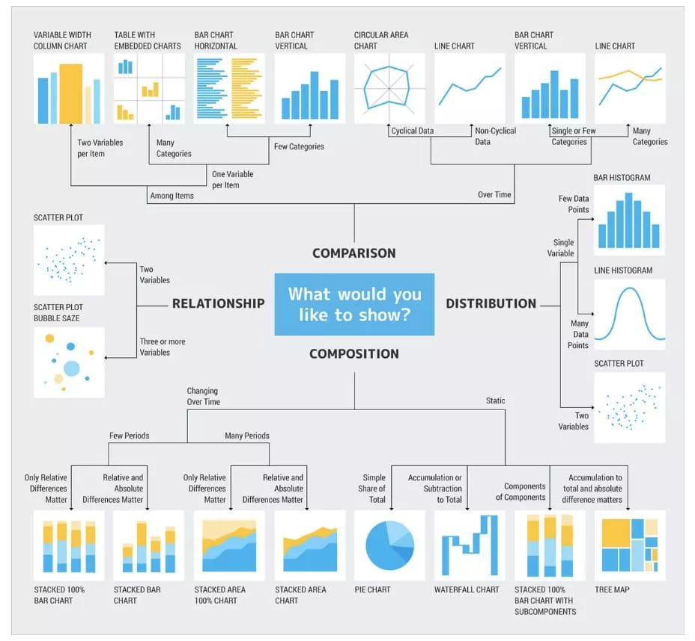
Best Practices for Visualizing Data (Some)
Know your audience
Keep it simple
Group together visualizations that demonstrate a theme
Stay away from 3D plots
Avoid distorting what the data is telling you
Reference: Janis Gulbis https://eazybi.com/blog/data_visualization_and_chart_types/

Slide 26
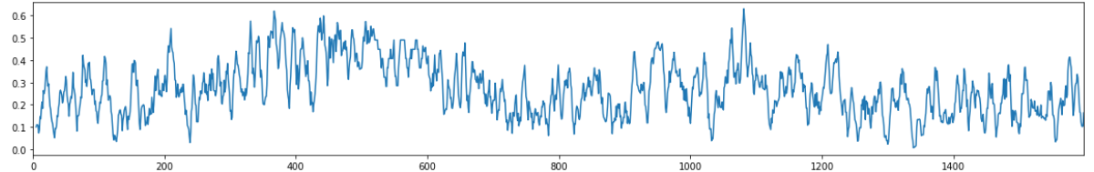
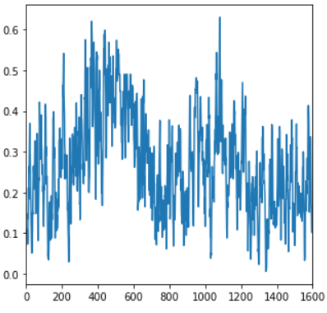
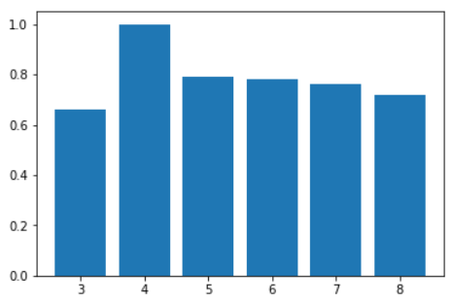
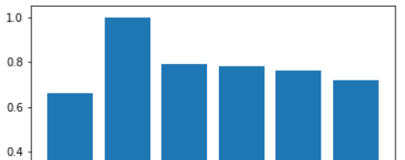
Avoid Distorting What the Data is Telling You

Slide 27
Practice - Notebook

Slide 28
Homework (Due March 4, 2020)
Exploratory Data Analysis.ipynb
Complete and upload to github
Add your name to submitted document
Simple Viz.ipynb
Complete and upload to github
Add your name to submitted document
Advanced Viz.ipynb
Complete and upload to github
Add your name to submitted document

Slide 29
Week 3
Date: March 4, 2020

Slide 30
Overview
Split into teams
Review last week’s EDA results – any interesting results? Any ideas?
Back to problem statement/description
Custom functions to create new columns
Data cleaning- imputation and null values
Begin transformation pipeline

Slide 31
Custom functions to create new columns
The apply function
The applymap function
https://pandas.pydata.org/pandas-docs/stable/reference/api/pandas.DataFrame.apply.html
https://pandas.pydata.org/pandas-docs/stable/reference/api/pandas.DataFrame.applymap.html

Slide 32
Custom functions to create new columns
Lambda functions
Reference: https://realpython.com/python-lambda/
List Comprehension
Reference: https://docs.python.org/3/tutorial/datastructures.html

Slide 33
Data cleaning- imputation and null values
Displaying null records: print(dataset.isnull().sum())
The fillna method
The replace method
The dropna method: https://machinelearningmastery.com/handle-missing-data-python/

Slide 34
Data cleaning- imputation and null values
Mean imputation with sklearn impute transform
Median imputation with sklearn impute transform

Slide 35
Practice in Notebook
Data Transformation Pipeline Notebook
Data Transformation Pipeline (Complete) Notebook

Slide 36
Homework (Due March 11, 2020)
Define a segment of code that accomplishes the tasks discussed in class (Data Science Practicum for Business with Python – Data Transformation Pipeline - Winter 2020)
Remember, there needs to be a target and features left over
Finish EDA documentation in a Notebook using the markdown language and showcase a single visualization you feel is important
Do this individually, then submit to your github account with me as a reviewer
Gather or collaborate with your team members to align on what you saw from the EDA and the data transformation steps you think are needed so far and list them somewhere for your own benefit (don’t have to submit anything here)

Slide 37
Week 4
Date: March 18, 2020

Slide 38
Overview
Team meeting – 15 minutes
Talk about what classes you are currently taking for an introduction
Create a list of emails for your team members in Outlook/Google
What is a good meeting time/place outside of class for you to meet if you must?
Talk about the finished Data Transformation pipeline
What would you do if we added another column to the original data?
Problem statement
Elasticity – what does this mean?
How we can we estimate elasticity of a product (in this case, vehicle)?
Machine learning introduction – What is machine learning?
Regression type problems (Notebook)
Log transformations (Notebook)

Slide 39
Team meeting – 15 minutes
Team meeting – 15 minutes
Talk about what classes you are currently taking for an introduction
Create a list of emails for your team members in Outlook/Google
What is a good meeting time/place outside of class for you to meet if you must?
Talk about the finished Data Transformation pipeline
What would you do if we added another column to the original data?

Slide 40
Problem Description
Name Trim Model packaging
Use Case: Maximize margin through steps between trim levels, packaging, options, etc.
Final Deliverable: An elasticity model that suggests pricing gaps between trim levels, packaging, options, etc. that will generate the best volume and margin results.
Notes
The stakeholders use the term ‘elasticity’ model in their description…what does that even mean?
Would a price decrease in one trim level mean a volume decrease for another trim (cannibalization)?
Is there a ‘sweet spot’ for price of a trim so we can maximize volume and not impact another trim?

Slide 41
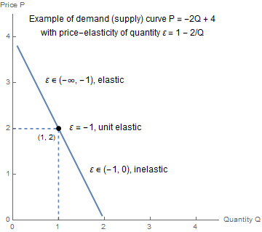
Elasticity
What is “elasticity?”
Elasticity is a concept that tells us how much the change of one thing leads to change in another
In our example (and most): How much does a change in price mean a change in sales (volume)?
It is also a metric that can be easily interpreted
The metric usually is not the same (constant) at all price points, but sometimes it is and can be a useful assumption

Slide 42
Elasticity – Go to the Board
Much easier than reading from slides

Slide 43
What is Machine Learning?
AI
Machine Learning
Deep Learning
Artificial Intelligence (AI): A computer and data driven solution that performs a talk that usually takes the intelligence of a human to complete.
Machine Learning: A computer’s (machine’s) ability to learn patterns from data that allow it to complete a specific task.
Deep Learning: A subset of machine learning that uses techniques that mimic the actions of a human brain.

Slide 44
Unsupervised versus Supervised Learning
Unsupervised
supervised
Analytics and machine learning techniques that look for patterns in data without a target.
Examples:
K-means clustering
KNN
Principal components analysis
Machine learning techniques that look for patterns in data that best explain a target.
Examples:
Elastic net regression
Spline regression
Neural networks
Random Forest Classifiers

Slide 45
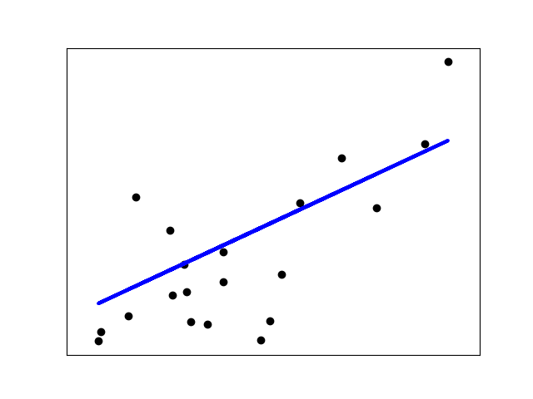
Regression Type Problems
Regression problems are supervised learning problems with a continuous target.
Think about predicting a number on a scale
Examples:
How long will a shipment take to be delivered?
How many mugs will we sell in January if we decrease price?
What will the auctioned price of a product be at auction based on historical auctions of similar products?
Image source: https://scikit-learn.org/stable/auto_examples/linear_model/plot_ols.html

Slide 46
Ordinary Least Squares (OLS) – How Basic Regression Models Learn From Data
This is the first step on the regression path – default loss function
I wish we had the time to really get into this subject (a semester-long class is not unheard of)
What does an OLS regression model tell us?
It tells us what the expected value (average) of a target will be based on the levels of the input variables, or x variables.
It tells us, for every variable in the model, what the average effect that variable has on a product, given everything else is held constant.

Slide 47








Ordinary Least Squares (OLS) – How Basic Regression Models Learn From Data
Formulas in notebooks…
$$ε_{i}$$
$$ε_{i}$$
Image source: https://scikit-learn.org/stable/auto_examples/linear_model/plot_ols.html
Each observation has an error (residual) associated with it (epsilon)
The errors are squared, and then summed to give an idea of how good the line is
Why not just use the absolute value of the error……????
This extends to high dimensions
The error is still the actual minus the predicted squared
$$ε_{i}$$
$$ε_{i}$$
$$ε_{5}$$
$$ε_{5}$$
$$ε_{1}$$
$$ε_{1}$$

Slide 48
Fitting a Regression Model (Python)
Scikit learn (sklearn)
statsmodels
You need a target and explanatory (exogenous) variables with the same length
Import the package
Create an instance of the model
This is where you state hyperparameters if you want
Fit the model to data (needs to be arrays for sklearn)
Refer to the documentation for methods that return information about the fitted model
Coefficients
Predictions
Residuals (errors)
Etc.
https://scikit-learn.org/stable/modules/linear_model.html#ordinary-least-squares
You need a target and explanatory (exogenous) variables with the same length
Import the package
Create an instance of the model
This is where you state hyperparameters if you want
Fit the model to data (can be dataframe or a formula)
Refer to the documentation for methods that return information about the fitted model
Coefficients
Predictions
Residuals (errors)
Etc.
A nice pro for the statsmodels package is the ease of viewing results
If you use or plan on using R for your job, then a lot of this package will make sense to you

Slide 49
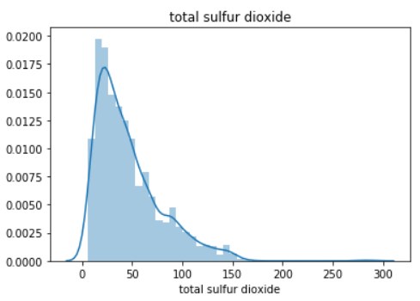
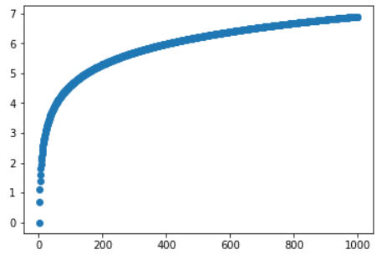
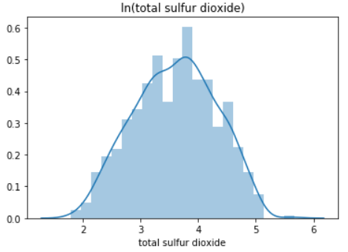
Log Transformations on Data
Let’s add a log transformation to the transformation pipeline
Why would we want to do this? Two reasons:
Its basically a fix for some right-skewed distributions
The interpretation is more appropriate for some independent variables

Slide 50
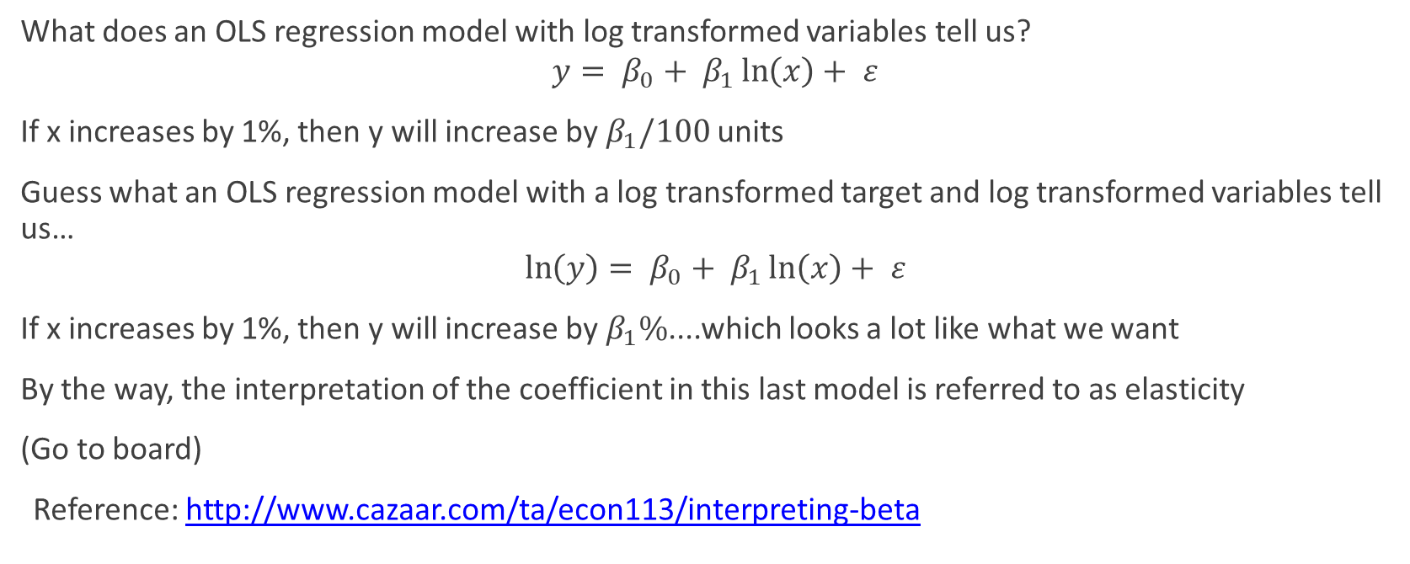
Log Transformations in Fitted Models
What does an OLS regression model with log transformed variables tell us?
$$y= β_{0}+ β_{1}\ln\left(x\right)+ ε$$
If x increases by 1%, then y will increase by $β_{1}/100$ units
Guess what an OLS regression model with a log transformed target and log transformed variables tell us…
$$\ln\left(y\right)= β_{0}+ β_{1}\ln\left(x\right)+ ε$$
If x increases by 1%, then y will increase by $β_{1}\%$....which looks a lot like what we want
By the way, the interpretation of the coefficient in this last model is referred to as elasticity
(Go to board)
Reference: http://www.cazaar.com/ta/econ113/interpreting-beta

Slide 51
Finish in Notebooks
Use remaining time to focus on regression models in python

Slide 52
Homework (Due March 25, 2020)
Complete
Complete the notebook on regression type problems
Complete the notebook on aggregation and elasticity
Upload the completed notebook to your github and notify me to review or just to look at it.
Add
Add a grouping step to the transformation pipeline to give a daily total count of cars sold and the average MSRP by solddate and any other important descriptors (nameplate, business center, etc.)
Add
Add a log transformation step to the transformation pipeline & documentation
What features/columns need a log transformation?
Should you create a new feature or change one in-place?
Fit
Fit a regression model to our dataset
Use the count or volume as your target for a trim
See how well you can predict the volume of daily trim sales using some of the available features

Slide 53
Week 5
Date: March 23, 2020

Slide 54
Overview
FCA Data Science & Business Analytics example
Review problem statement description for this course
Review current state and toolset
Schedule for the remaining sessions
Revisit Machine Learning
Classification type problems
Multiclass classification
Example in Python
Homework for teams & individuals

Slide 55
Review Problem Description
Name Trim Model packaging
Use Case: Maximize margin through steps between trim levels, packaging, options, etc.
Final Deliverable: An elasticity model that suggests pricing gaps between trim levels, packaging, options, etc. that will generate the best volume and margin results.
Notes
The stakeholders use the term ‘elasticity’ model in their description…does this still make sense to use?
Would a price decrease in one trim level mean a volume decrease for another trim (cannibalization)?
Is there a ‘sweet spot’ for price of a trim so we can maximize volume and not impact another trim?
Would changing the price of one nameplate make it look more or less like another nameplate from a machine’s perspective?

Slide 56
Review Current State and Toolset
Week 1: Github and Jupyter notebooks, Python and Pandas
Week 2: EDA, visualization tools (matplotlib and seaborn) and automotive terminology
Week 3: Custom functions in python, data transformations and data transformation pipeline. Team numbers and team members shared with class.
Week 4: Intro to machine learning in python, simple linear regression in python, multiple linear regression in python, log transformations and elasticity. Now on Microsoft Teams. Team numbers and team members shared with class again.
Current state: problem statement and definition from business, basic understanding of underlying business, dataset to support solution, preliminary EDA and understanding of data transformations needed, toolset for calculating elasticity.

Slide 57

Schedule for Remaining Classes
March 25, 2020: Week 5 – Classification in Python
April 1, 2020: Week 6 – Bringing it all together in Python
April 7, 2020: Week 7 – Open hours – Work on project in class (on Microsoft Teams)
April 15, 2020: Week 8 – Take-home Exam and Final Assignment due 5:30PM

Slide 58
What is Machine Learning Again?
AI
Machine Learning
Deep Learning
Artificial Intelligence (AI): A computer and data driven solution that performs a talk that usually takes the intelligence of a human to complete.
Machine Learning: A computer’s (machine’s) ability to learn patterns from data that allow it to complete a specific task.
Deep Learning: A subset of machine learning that uses techniques that mimic the actions of a human brain.

Slide 59
Unsupervised versus Supervised Learning
Unsupervised
supervised
Analytics and machine learning techniques that look for patterns in data without a target.
Examples:
K-means clustering
KNN
Principal components analysis
Machine learning techniques that look for patterns in data that best explain a target.
Examples:
Elastic net regression
Spline regression
Neural networks
Random Forest Classifiers

Slide 60
Classification Type Problems
Classification problems are supervised learning problems with a categorical target
Think about predicting a “yes” or “no”, or predicting “High”, “Medium” or “Low”
Examples:
Will this shipment be on time or be late?
Is the animal in this picture a dog, cat, or duck?
Is the item up for auction furniture or jewelry based on price and other features?

Slide 61
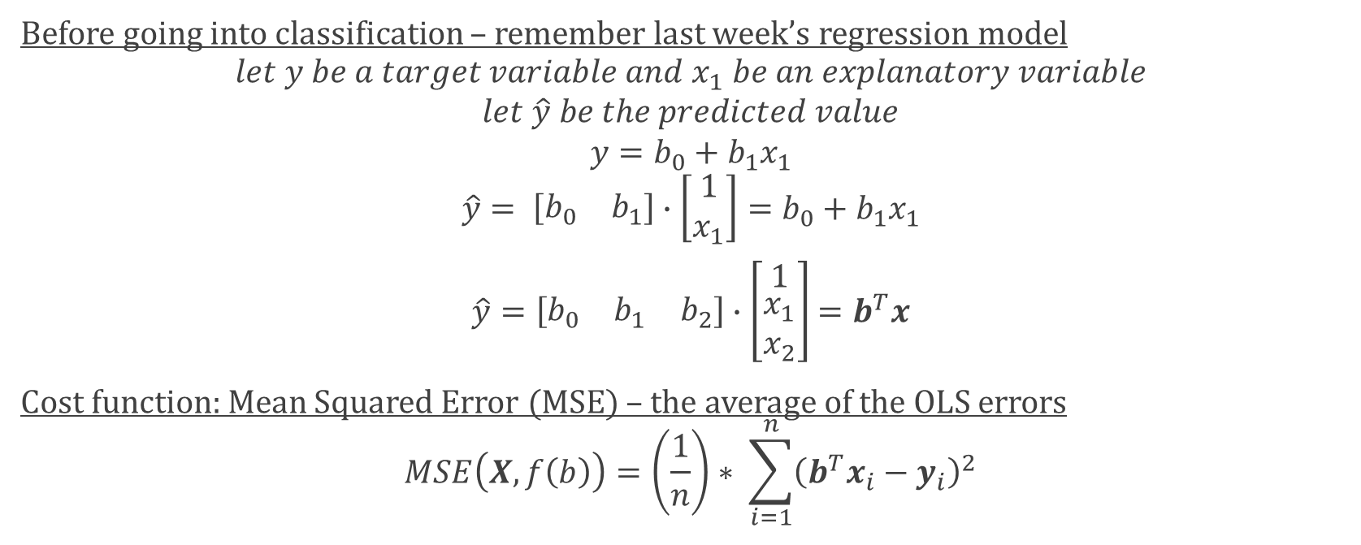
How Machines Learn to Classify part 1
Before going into classification – remember last week’s regression model
$$let y be a target variable and x_{1} be an explanatory variable$$
$$let \hat{y} be the predicted value$$
$$y=b_{0}+b_{1}x_{1}$$
$$\hat{y}= \left[\begin{matrix}b_{0} & b_{1}\end{matrix}\right]∙\left[\begin{matrix}1 \\ x_{1}\end{matrix}\right]=b_{0}+b_{1}x_{1}$$
$\hat{y}=\left[\begin{matrix}b_{0} & b_{1} & b_{2}\end{matrix}\right]$ $∙\left[\begin{matrix}1 \\ \begin{matrix}x_{1} \\ x_{2}\end{matrix}\end{matrix}\right]$ $=b^{T}x$
Cost function: Mean Squared Error (MSE) – the average of the OLS errors
$$MSE\left(X,f\left(b\right)\right)=\left(\frac{1}{n}\right)∗ \sum_{i=1}^{n}{{\left(b^{T}x_{i}−y_{i}\right)}^{2}}$$

Slide 62
How Machines Learn to Classify part 2
So, we understand that we have a cost function, which tells the machine how well the parameters of the model performed on the given dataset
We saw it in action with the regression model last week
For classification, error isn’t judged in terms of distance from an actual value like regression
Instead, use the difference in the predicted probability of a class from the actual class
Different from the confusion matrix
How to predict a y belonging to a class?
Use the sigmoid function

Slide 63
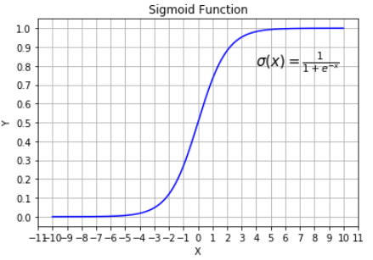
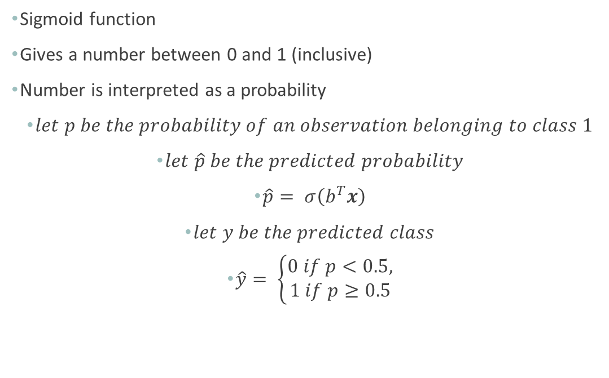
How Machines Learn to Classify part 3
Sigmoid function
Gives a number between 0 and 1 (inclusive)
Number is interpreted as a probability
$let p be the probability of an observation belonging to class 1$
$let \hat{p} be the predicted probability$
$\hat{p}= σ\left(b^{T}x\right)$
$let y be the predicted class$
$\hat{y}= \left\{\begin{matrix}0 if p<0.5, \\ 1 if p≥0.5\end{matrix}\right.$
https://gist.github.com/Will-777/ad278c345639d24efb9d4cd275addbd2

Slide 64
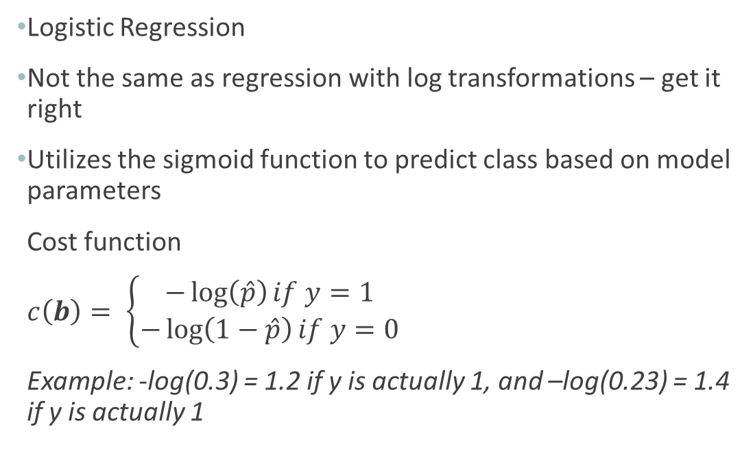
How Machines Learn to Classify part 4
Logistic Regression
Not the same as regression with log transformations – get it right
Utilizes the sigmoid function to predict class based on model parameters
Cost function
$c\left(b\right)= \left\{\begin{aligned}−\log\left(\hat{p}\right)if y=1 \\ −\log\left(1−\hat{p}\right)if y=0\end{aligned}\right.$
Example: -log(0.3) = 1.2 if y is actually 1, and –log(0.23) = 1.4 if y is actually 1

Slide 65

How Machines Learn to Classify part 4
Cost function for Logistic Regression
Log Loss$(b)$ = $−\left(\frac{1}{n}\right)\sum_{i=1}^{n}{[y_{i}\log\left(p_{i}\right)+\left(1−y_{i}\right)∗log⁡(1−p_{i})]}$
“Softmax” Classification
$s_{k}\left(x\right)=b_{k}^{T}x$
$\hat{p_{k}}= σ{\left(s\left(x\right)\right)}_{k}=\frac{e^{s_{k}\left(x\right)}}{\sum_{j=1}^{k}{e^{s_{j}\left(x\right)}}}$
$\hat{y}=argmax_{k} σ{\left(s\left(x\right)\right)}_{k}$

Slide 66

How Machines Learn to Classify part 5
Cost function for Softmax
Log Loss$(b)$ = $−\left(\frac{1}{n}\right)\sum_{i=1}^{n}{\sum_{k=1}^{K}{\left[y_{i}^{k}\log\left(p_{i}^{k}\right)\right]}}$
$Where K is total number of classes, i is the observation$

Slide 67
Fitting a Classification Model (Python)
Scikit learn (sklearn)
You need a target and explanatory (exogenous) variables with the same length
Import the package
Create an instance of the model
This is where you state hyperparameters if you want
Fit the model to data (needs to be arrays for sklearn)
Refer to the documentation for methods that return information about the fitted model
Coefficients
Predictions
Residuals (errors)
Etc.

Slide 68
Homework (April 1, 2020)
Team:
How can you turn this regression type problem into a classification problem? Pose your ideas to your team
Can you accurately predict what nameplate is being sold based on things like price and options? Does seasonality play any part in this?
Select a member to start building the presentation
That member should create an outline to share with the team
Go over your individual EDA results from before (since we did not get to adequately do this before during class) with your team
Does anything stand out now, or no?
Individual:
Finish the classification notebook, upload to your github, and list me as a reviewer

Slide 69
Week 6
Date: April 1, 2020

Slide 70
Bringing it Together
Refer to notebook:
“Data Science Practicum for Business with Python - Bringing it Together.ipynb”

Slide 71
Homework (Due April 7th, 2020)
Begin working on final assignment
Final assignment instructions were sent via email attachment
Come with questions and ideas

Slide 72
Week 7
Date: April 7, 2020

Slide 73
Week 7
Final Assignments are due on April 15th at 5:30pm (sent to my email address at casey.whorton.waynestate@gmail.com)
Final Exams are due on April 15th at 5:30pm (sent to my email address at casey.whorton.waynestate@gmail.com)
Work on final assignment in class using Microsoft Teams from 5:30pm to 7:30pm or beyond

